Slide 1

Introduction to Flee
Adama Science and Technology University
July 2019
Gebremariam Assres
Derek Groen
DIana Suleimenova

Slide 2
Activities
Lecture: Flee migration model basics
Agent-based modelling
Key concepts in Flee
Basic Flee simulations:
Hands-on: Installing and running basic Flee simulations
Lecture: Migration simulation scenarios (Mali,CAR,Burundi) + current results
Discuss in groups: How to use Flee for the Ethiopian context (Chair: Gebre)
Classical Discussion: How to use Flee for the Ethiopian context (Chair: Gebre)
Using Flee for specific situations:
Lecture: Simulating forced migration in South Sudan
Hands-on: Using Flee for specific situations
Discuss in groups (with note taking): How we can make these simulations more realistic and accurate, or answer more relevant questions (Chair: Derek)
Notes:
Lecture 50 minutes:, discussion: 40 minutes, hands-on: 75 minutes, break: 15 minutes.

Slide 3
Flee migration model basics

Slide 4
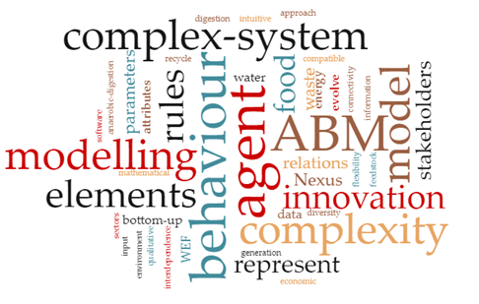
Agent-based modelling
A computational approach used to model complex systems.
Models how agents and their environment vary across time and space
It consists of agents that represent animals, humans, organisations or any other types of entities interacting with each other and within their environment
There is no consensus on the exact definition of the term agent
However, agents are autonomous and often unique, meaning that each agent is distinct in terms of attributes, behaviour, size and location
Suitable for modelling active objects in relation to time, event or behaviour.
Notes:
It allows a heterogeneous mix of many agents to act and interact autonomously, in turn leading to emergent behaviours in the system at higher levels (agents, agents’ relationships and their environment)

Slide 5
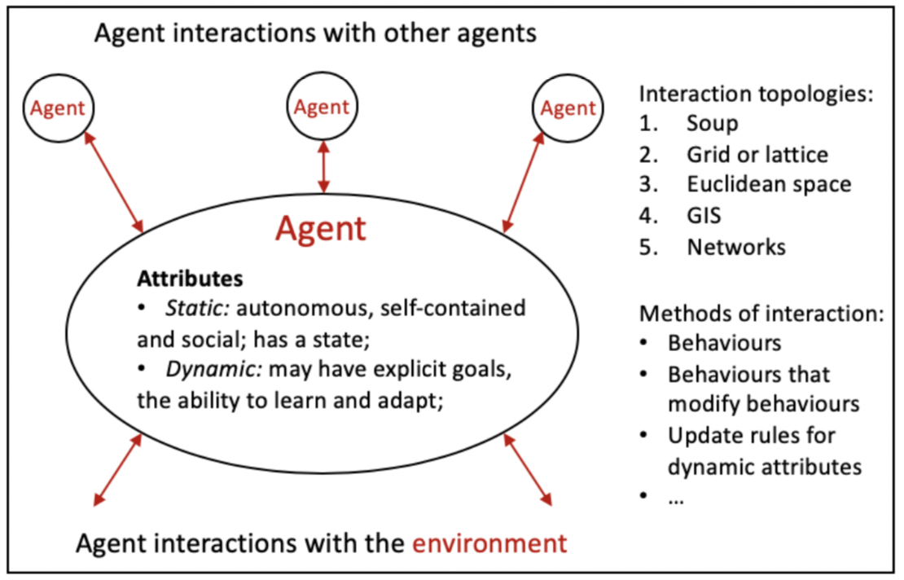
Agent-based modelling (cont.)
Three elements of agent-based models, namely agents, agents’ relationships and
their environment.
Suleimenova, D. (2019) ‘Predicting forced displacement using a generalised and automated agent-based simulation”.

Slide 6

Agent-based modelling (cont.)
The initial concept of ABM was introduced in the late 1940s
However, it has become popular in the 1990s as the use of ABM required computational advancements
It is widely applied to various research disciplines: biology, business, economics, social sciences, and technology, and practical areas including infrastructure, civilisation, terrorism, military and crowd modelling
It can explicitly model social interactions and networks emerging from it
Newly emerging application domains: cyber-security and the social factors of climate change.

Slide 7
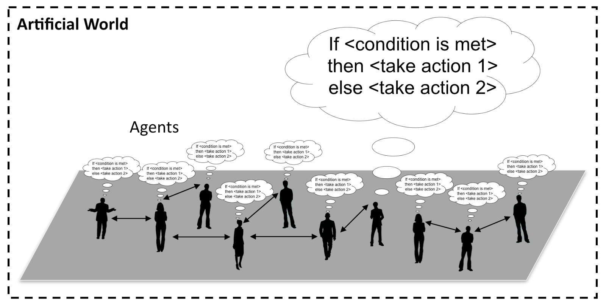
Agent-based modelling (cont.)
Agent behavior (image source: https://www.gisagents.org/2016/)

Slide 8
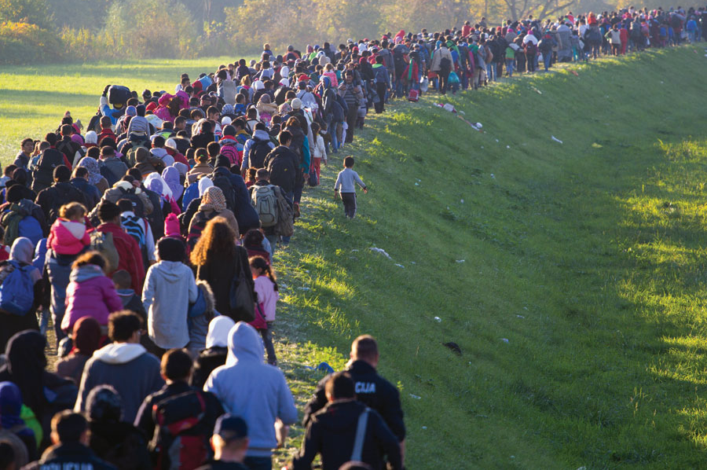
Key concepts in Flee
Flee is an agent-based simulation code
Written in Python
Used for simulating movement of individuals across geographical locations.
Primarily focuses on refugees and internally displaced persons.
It is optimised for simplicity and flexibility.

Slide 9
Key concepts in Flee (cont.)
Simulate one day at a time.
Each agent decides:
Do I stay put, or move to a neighbouring location?
If I move, which location shall I go to?
Each agent represent one refugee.
Humans are smart, agents are not but do make simple autonomous decisions
?
A

Slide 10

Key concepts in Flee (cont.)
Flee license:
Open-source community code
https://github.com/djgroen/flee-release
Released under a BSD 3-clause license
Activities in the Flee migration model:
Modelling the movements of people
Simulation
Visualization
Source: https://gilcrease.org/migrations/

Slide 11
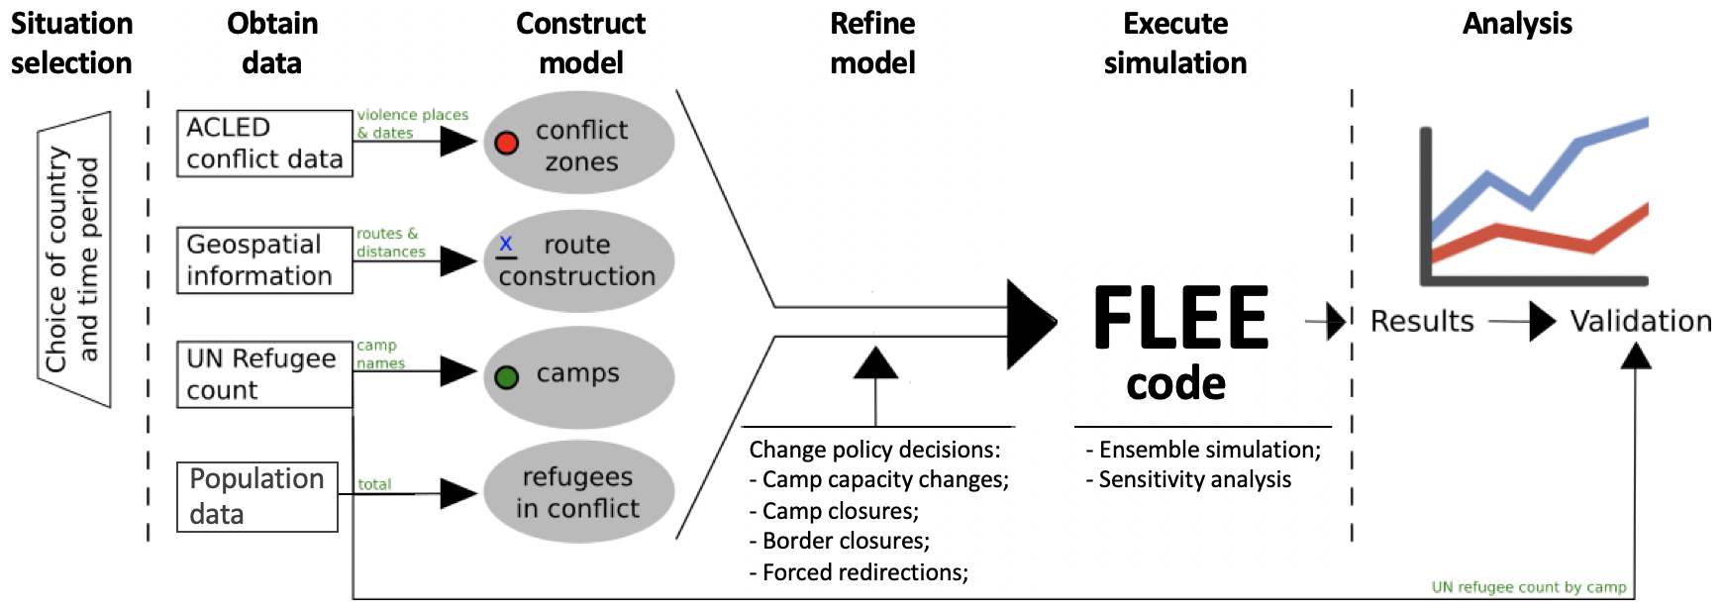
Simulation development approach using Flee
Simulation development approach for predicting the distribution of refugee arrivals across camps.

Slide 12
Flee architecture
Main source files:
File name | What it does
flee/flee.py | Main ABM kernel
flee/SimulationSettings.py | Data structure for global sim parameters.
analysis.py | Library with statistical analysis routines.
DataTable.py | Data Handling kernel for csv data.

Slide 13
Install and run basic Flee simulations
To perform this tutorial:
Clone the Flee code: git clone https://github.com/djgroen/flee-release.git
Install packages: Python3, and Python libraries (numpy, pandas, and matplotlib)
Linux \ Ubuntu - Terminal
$ sudo apt-get install python3
$ sudo apt-get install pip
$ sudo pip install numpy
$ sudo pip install pandas
$ sudo pip install matplotlib
Microsoft Windows - Command Prompt
Anaconda: https://www.anaconda.com/distribution/#windows
Download and Install Anaconda
Open Anaconda Navigator
Open Spyder IDE
https://docs.anaconda.com/anaconda/user-guide/getting-started/
macOS - Terminal
$ xcode-select --install
$ /usr/bin/ruby -e "$(curl -fsSL https://raw.githubusercontent.com/Homebrew/install/master/install)"
$ brew doctor
$ brew install python3
$ python3 -m pip install numpy scipy matplotlib

Slide 14
Running the Flee simulation code
1. To run the test example:
2. To run CSV-based simulation kernel using the test data:
* 2>/dev/null can be added at the end to ensure that any diagnostics are not displayed on the screen.
$ python3 test_csv.py
simulation period
$ python3 run_csv_vanilla.py test_data/test_input_csv test_data/test_input_csv/refugee_data 5 2010-01-01
script name
csv location
refugee data location
simulation start date

Slide 15
Running the Flee simulation code on Windows
1. To run the test example:
2. To run CSV-based simulation kernel using the test data:
$ runfile('test_csv.py', wdir='D:/Codes/flee/flee-release')
$ runfile('run_csv_vanilla.py', args='test_data/test_input_csv test_data/test_input_csv/refugee_data 5 2010-01-01', wdir='D:/Codes/flee/flee-release')

Slide 16
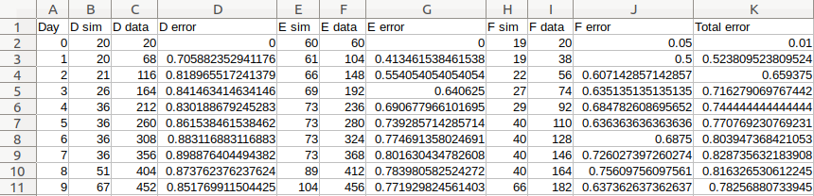
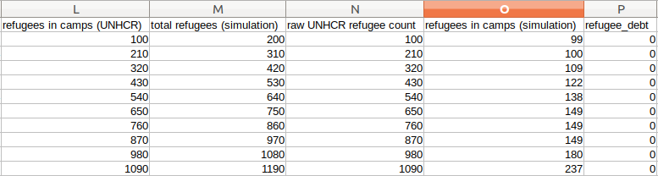
Simulation output
Output #1

Slide 17
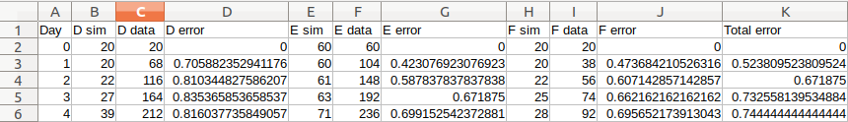
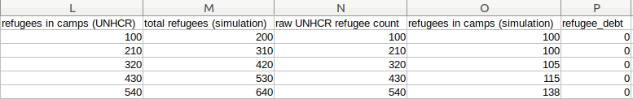
Install and run basic Flee simulations
Output #2

Slide 18
Hands-on:
Installing and running basic Flee simulations

Slide 19
Install and Run Flee
Try #1 – output into a CSV file, explore the output
Try #2 with same parameters – output into a CSV file, explore the output
Try #2 by changing the parameters

Slide 20
Migration simulation scenarios:
Mali, CAR and Burundi

Slide 21

Migration simulation scenarios
Flee-based predictions were performed for the distribution of refugees across camps in three African conflicts.
Prediction results were compared with the UNHCR refugee camp registration data for each conflict.
Thus, the averaged relative difference is less than 0.5 after the first few days, indicating that our simulations accurately predict more than 75% of the refugee movements in absolute terms.
The averaged relative difference is lower at later stages of the simulations.
Suleimenova et al. (2017) “A Generalized Simulation Development Approach For Predicting Refugee Destinations”, Scientific Reports, 7:13377.

Slide 22
Three refugee crisis instances
Country | Cause of conflict | Simulation
 |  | Start date | End date | Duration
Burundi (Bujumbura) | In April 2015, Pierre Nkurunziza sought to become the president for the third term. Election triggered protests, coups and a refugee crisis. | 1 May 2015 | 31 May 2016 | 396 days
Central African Republic (Bangui) | The Seleka group (Muslim population) overthrew the central government, in March 2013. Not long after, anti-Balaka (Christian militia groups) took over the power. Muslim and Christian communities started a long string of conflicts and violent attacks. | 1 December 2013 | 29 February 2016 | 820 days
Mali (Menaka) | Insurgent groups began a campaign to fight for independence of the Azawad region. Conflict started on the 16th January 2012, when Touareg rebels began conquering places in Northern Mali. | 29 February 2012 | 25 December 2012 | 300 days

Slide 23
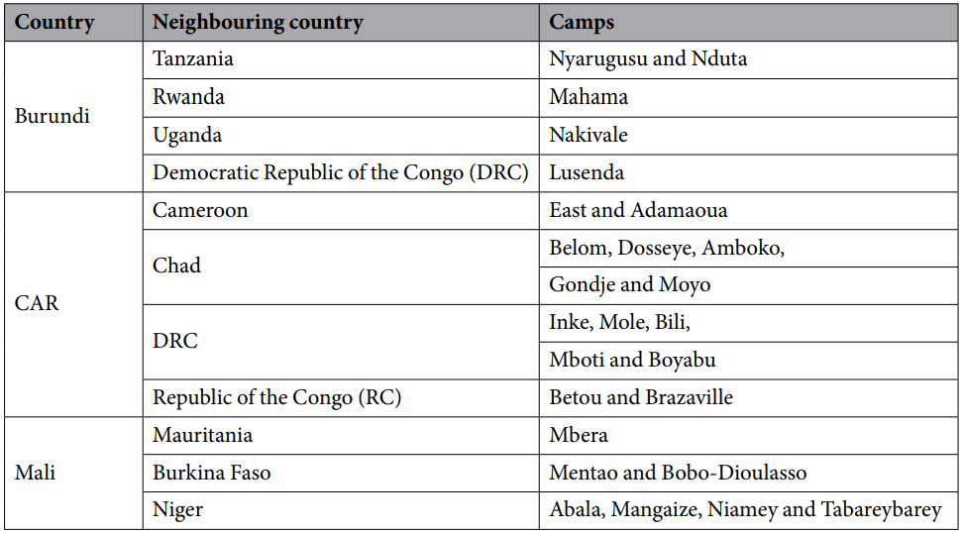
List of existing camps used in simulations

Slide 24
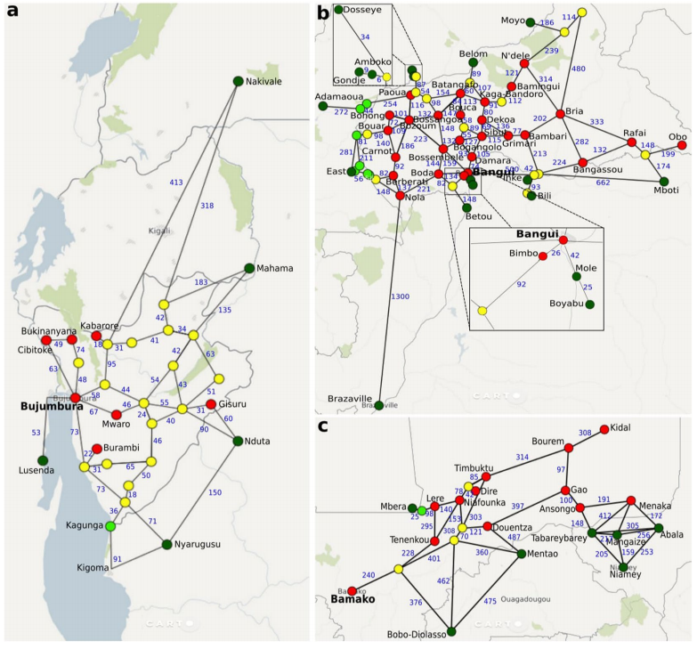
Overview of geographic network models for:
(a) Burundi,
(b) Central African Republic
(c) Mali.

Slide 25
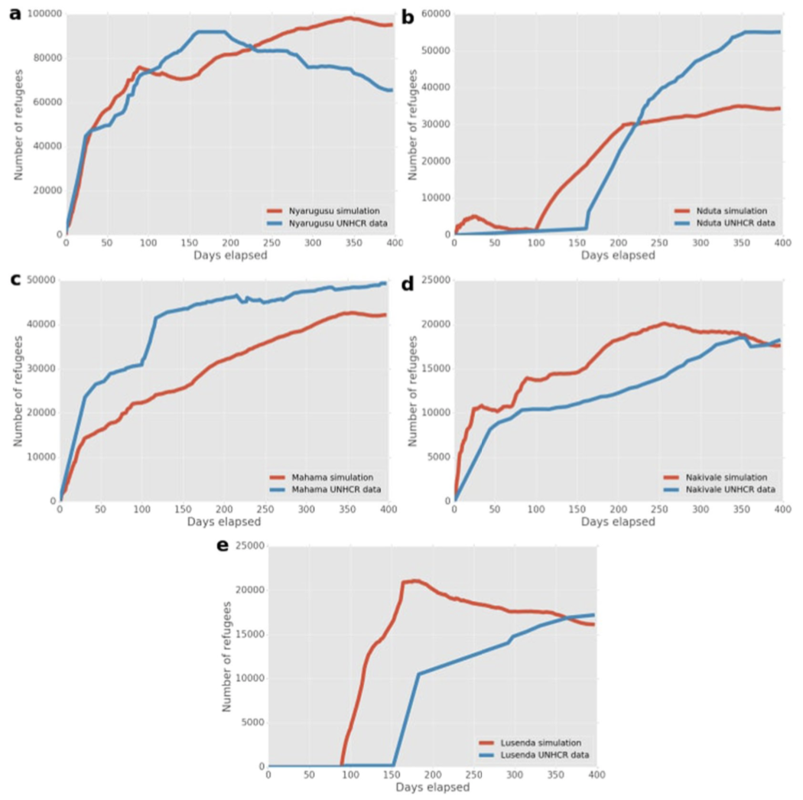
Burundi results
In Nyarugusu, Mahama and Nakivale camps, the simulation results accurately capture the key growth trends in refugees.
The refugee population growth in Mahama was underpredicted
Small population of travelling refugees at the start at Nduta and a steep increase to 30,000 was shown during the 90 days
Lusenda quickly fills to capacity in the simulation
Notes:
In Nyarugusu, Mahama and Nakivale camps, our simulation results accurately capture the key growth trends in refugees.
The refugee population growth in Mahama was underpredicted, as there was a delay in refugee arrival due to non-conflict settlements between Mahama and the conflict zones.
Small population of travelling refugees at the start at Nduta and a steep increase to 30,000 was shown during the 90 days after the camp was opened.
Lusenda, which opened on day 90, quickly fills to capacity in the simulation, whereas a more gradual increase was observed in the data. Here, the mismatch could be due to delays in the UNHCR registration process.

Slide 26
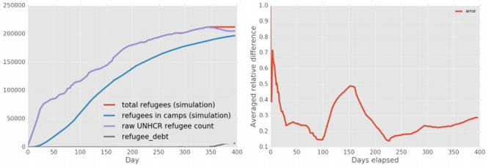
In general, our simulations showed fewer refugees in camps than the UNHCR measurements for the same day.

Slide 27
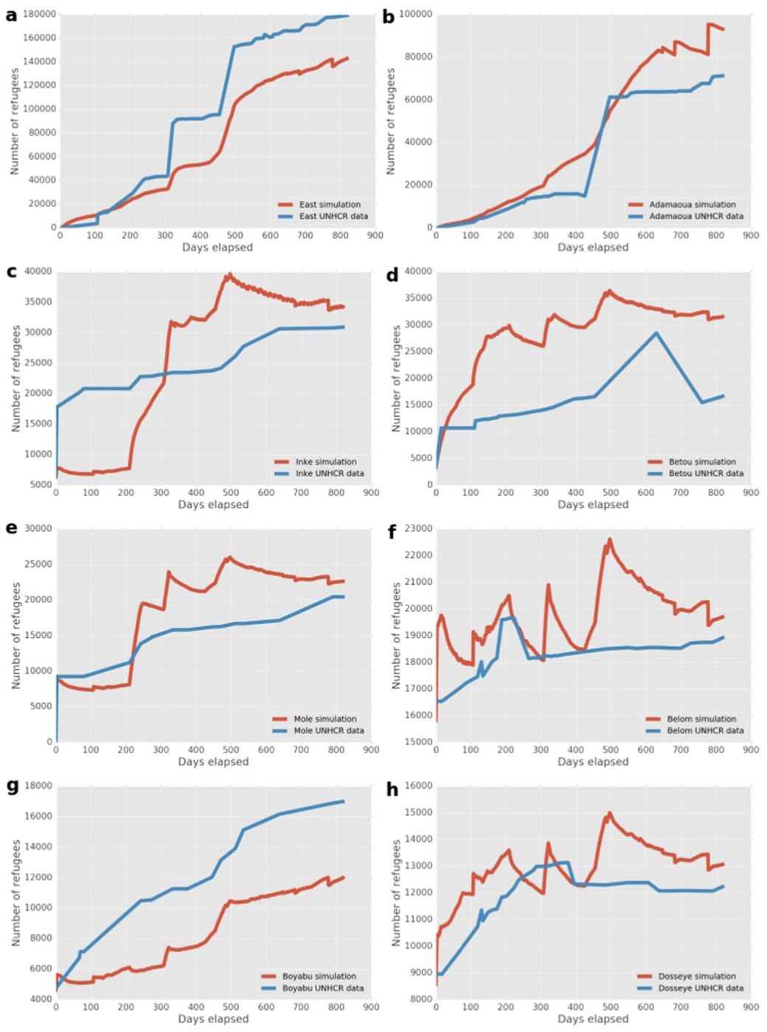
Central Africa Republic (CAR) results
Predictions closely follow the trends observed in the data for East Congo and Adamaoua.
Total refugee population was
underpredicted by ~20% in East Congo and
overpredicted by ~30% in Adamaoua.
The camps in DRC (Inke, Mole, Boyabu and Mboti) were subject to border closures between CAR and DRC during simulation day 4 and day 211.
The predicted refugee counts in Amboko, Belom, Dosseye and Gondje were in close agreement with the data
Notes:
Our predictions closely follow the trends observed in the data for the two largest camps, East Congo and Adamaoua.
Total refugee population was underpredicted by ~20% in East Congo and overpredicted by ~30% in Adamaoua .
The camps in DRC (Inke, Mole, Boyabu and Mboti) were subject to border closures between CAR and DRC during simulation day 4 and day 211 which was reflected by a stable population in the simulation as well as the UNHCR data.
The predicted refugee counts in the Chad camps (Amboko, Belom, Dosseye and Gondje) were in close agreement with the data.

Slide 28
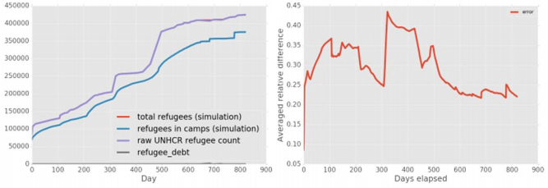
In general, the mismatch in the number of refugees in CAR remains relatively small, while the averaged relative difference fluctuates around 0.3.

Slide 29
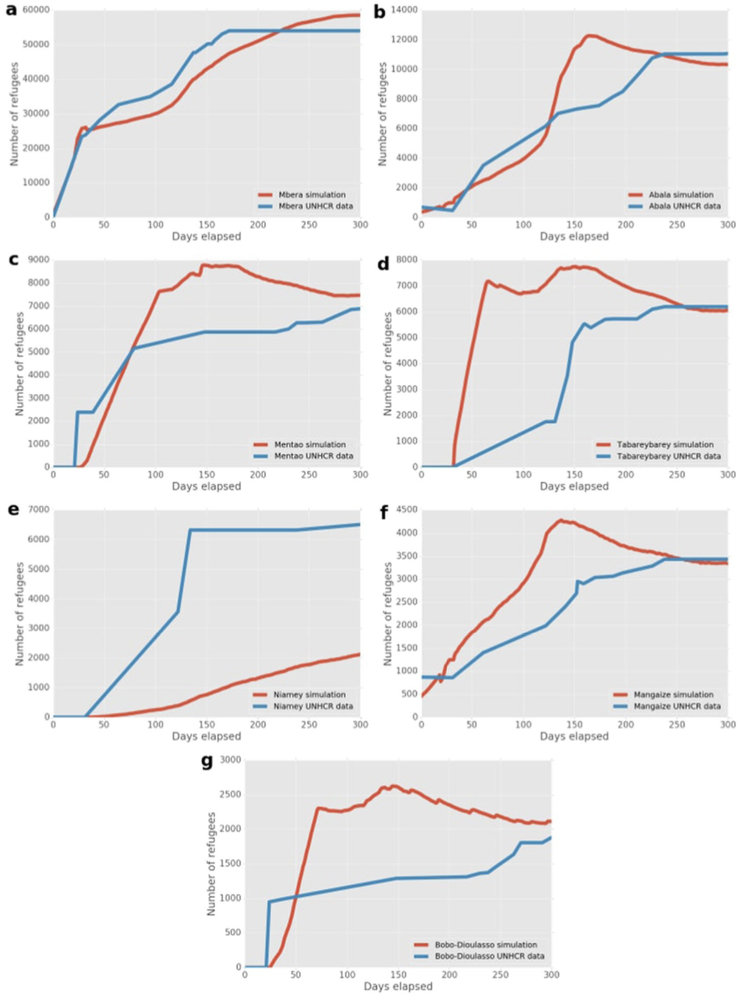
Mali results
Our simulation results are in close agreement with the data for the two largest camps (Mbera and Abala)
The maximum differences here are
underprediction of ~18% for Mbera around day 135
overprediction of ~60% for Abala around day 160
The simulation predicted a fast-paced growth of refugee population for both Mentao and Bobo-Dioulasso, while the data features a sudden spike in refugee arrivals
The simulation predictions for Mangaize in Niger are in line with the data, though slightly higher.

Slide 30
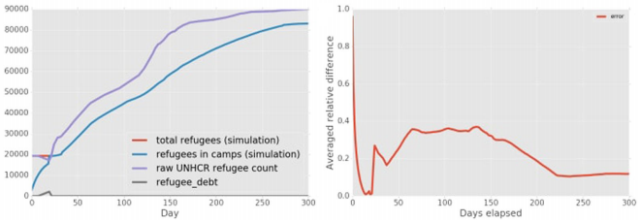
The number of refugees in camps in the simulation is relatively close to the reported number, and the averaged relative difference remains relatively constant.

Slide 31
Discuss in groups: How to use Flee for the Ethiopian context

Slide 32
Flee for the Ethiopian context
Make group of 5 members.
Nominate group rapporter.
Use the following starting points (but not only) relating to Flee.
Carry-on discussion for 15 minutes.
Write down the agreed upon points on sticky notes.

Slide 33
Flee for the Ethiopian context
Flee to infer/predict migration from neighbouring countries and internal displacement?
Migration from neighbouring countries
What factors influence the movement? Landscape, weather, culture, etc.?
Are there links between (conflict/push) locations and camps?
Internal displacement
What are the push/pull factors?
What factors influence the direction of movement?
Are there links between conflict locations and camps?

Slide 34
Classical Discussion:
How to use Flee for the Ethiopian context

Slide 35
Flee for the Ethiopian context
General discussion for 10 minutes
Groups rejoin and rapporter stick the notes on a common board.
Rapporteurs give explanations on the sticky notes.
Session chair summarizes the points.
The way forward noted.

Slide 36
Using Flee for specific situations

Slide 37
Procedure
Select a conflict scenario (country) and simulation (conflict) period
Obtaining data sources (e.g., conflict data)
Format
Run simulations

Slide 38
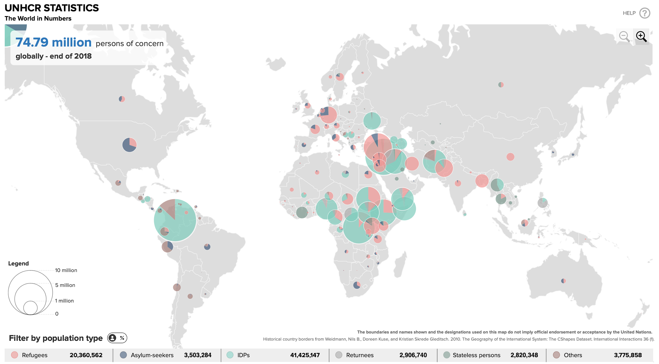

Slide 39
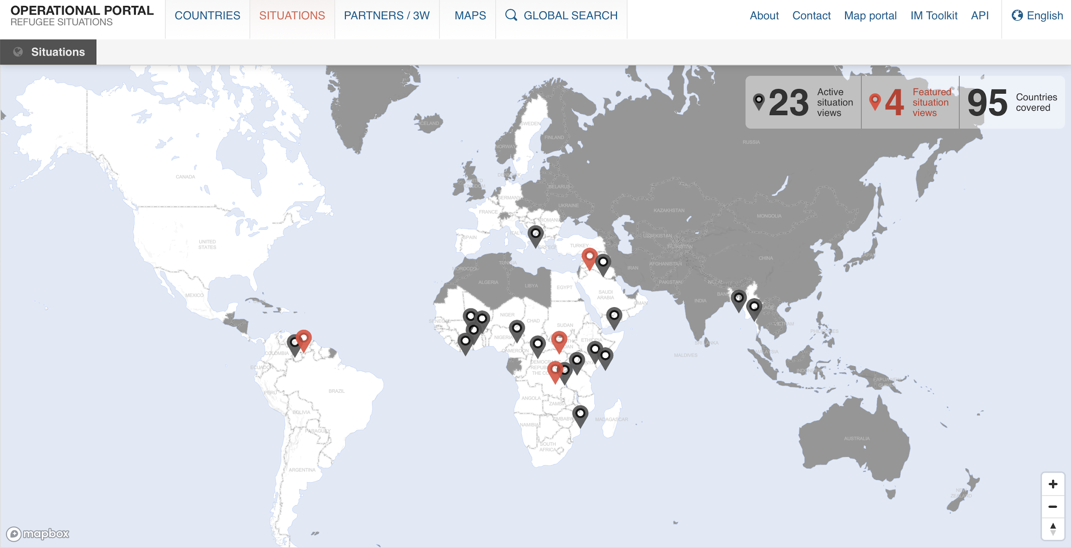
Select a conflict scenario
United Nations High Commissioner for Refugees (UNHCR): https://data2.unhcr.org/en/situations

Slide 40
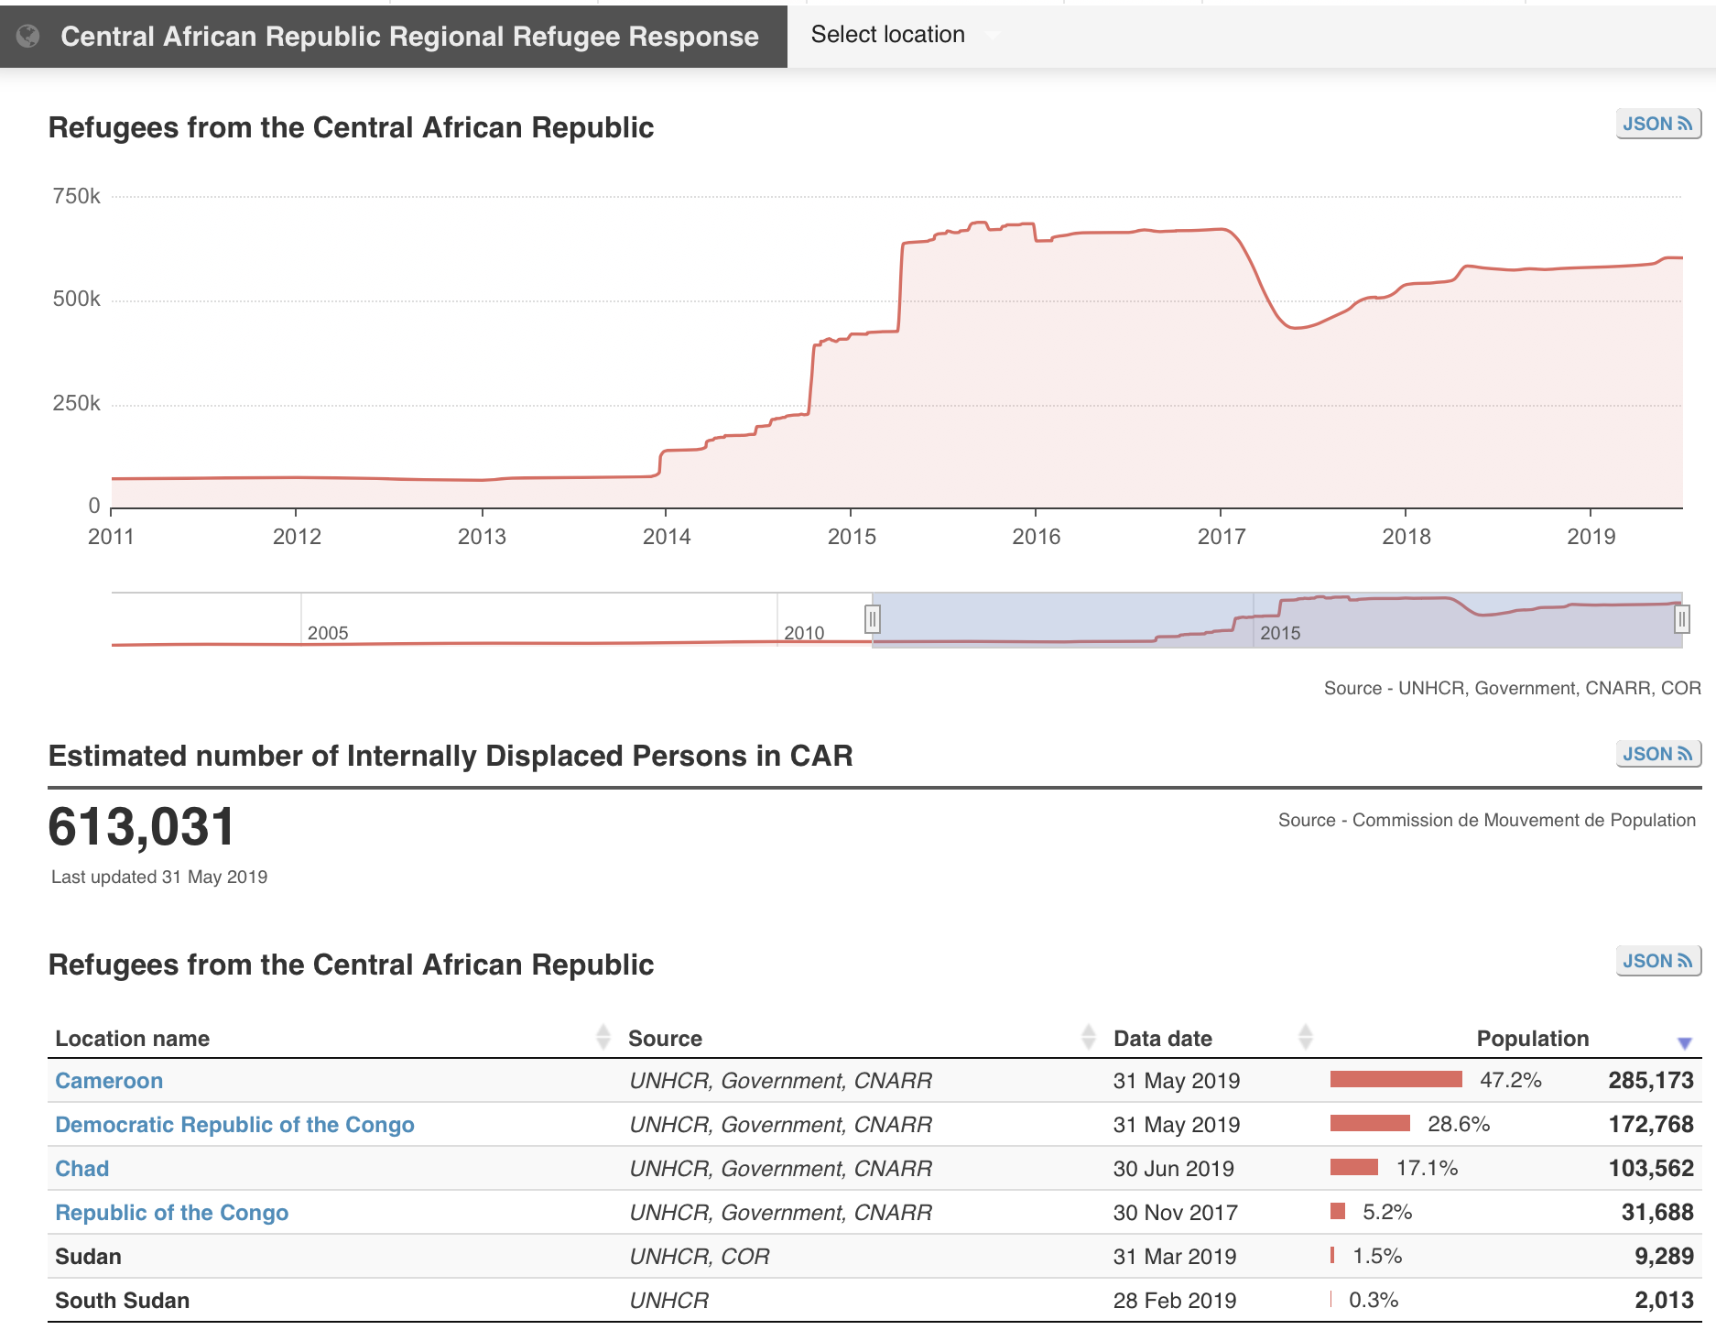
Select simulation period

Slide 41
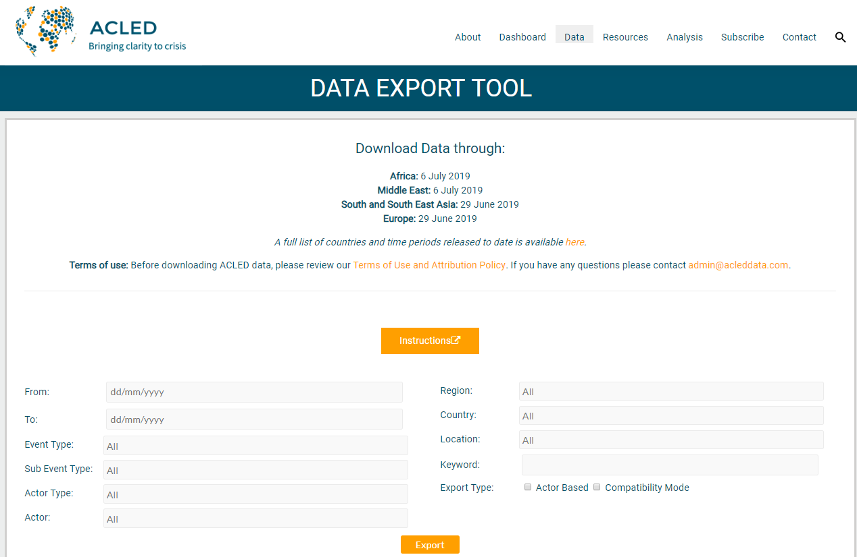
Obtaining data sources
Armed Conflict Location & Event Data Project (ACLED): https://www.acleddata.com/data/

Slide 42
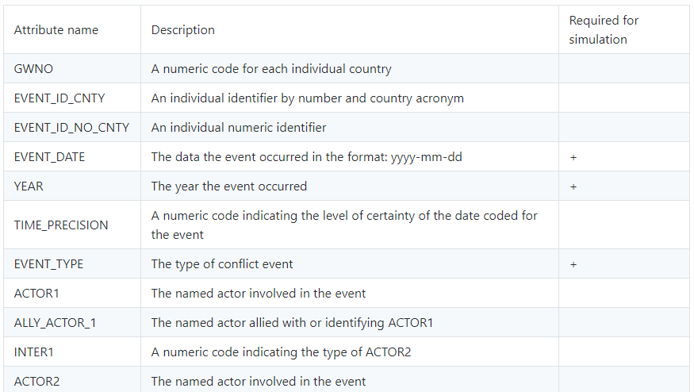
ACLED data format

Slide 43
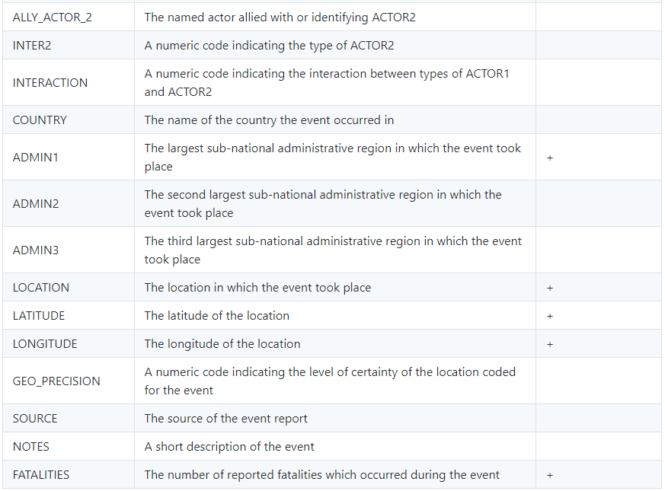
ACLED data format (cont.)

Slide 44
Formatting conflict data
Remove unrequired columns
Revise YEAR column and target chosen simulation period of conflict scenario
EVENT_TYPE column has 8 different variations
Use 3 variations of BATTLE: No change of territory, Government regains territory, Non-state actor overtakes territory
From FATALITIES column and remove fatalities that are equal to 0
To identify conflict locations for simulation, choose the first occurrence of each location but exclude syndicated (repeated) locations.

Slide 45
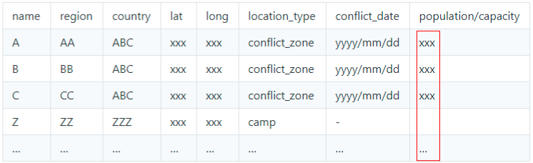
Structure of data sources for simulation
locations.csv
Fill population/capacity from
Population distribution
Camp capacity
Refugee data
Population distributions can be obtained from https://www.citypopulation.de or other sources.
Identify destination locations i.e. camps from UNHCR database and add the information to locations.csv

Slide 46
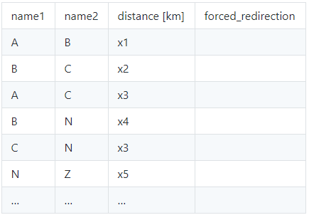
Structure of data sources for simulation
Determine main routes through which refugees flee:
Identify conflict locations (zones and camps)
Use http://www.bing.com/maps (or other mapping services)
Construct network map and create routes.csv
Forced_redirection:
0 indicates no redirection
1 indicates from name2 to name1
2 indicates from name1 to name2
routes.csv

Slide 47
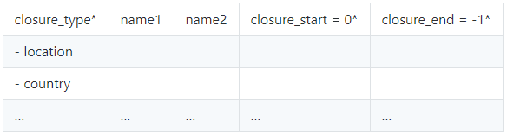
Using Flee for specific situations
Camp or border closure events:
closure_type has 2 values: camp closure or country (referring to border) closure
closure_start and closure_end are given as integers, counting the number of days after the simulation start.
value of 0 indicates the start, while -1 indicates the end of the simulation.
closures.csv

Slide 48
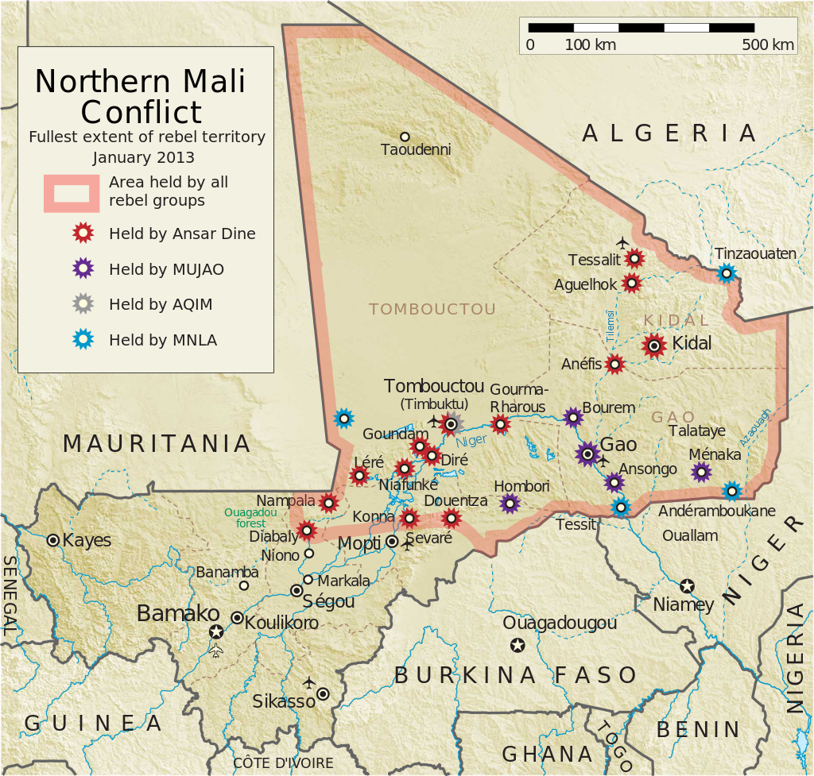
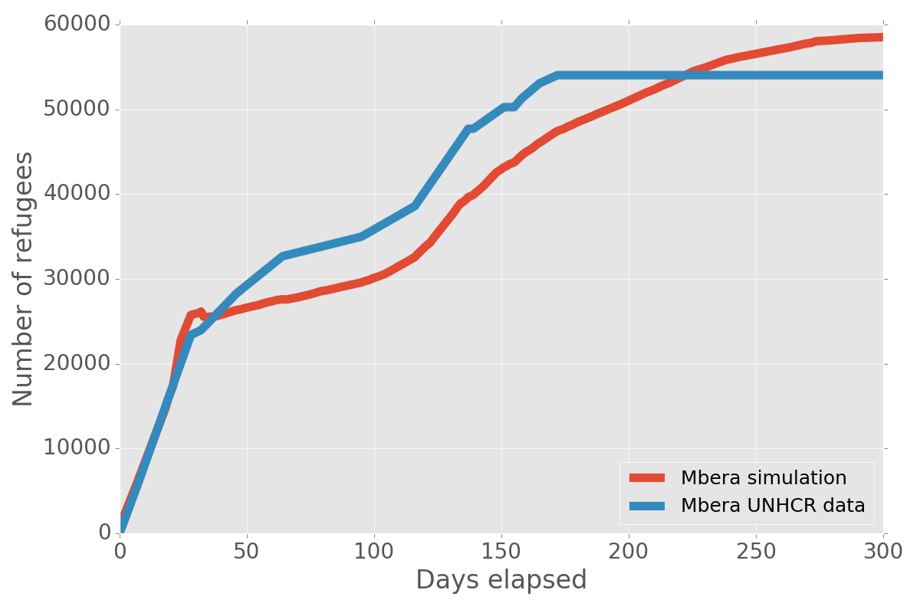
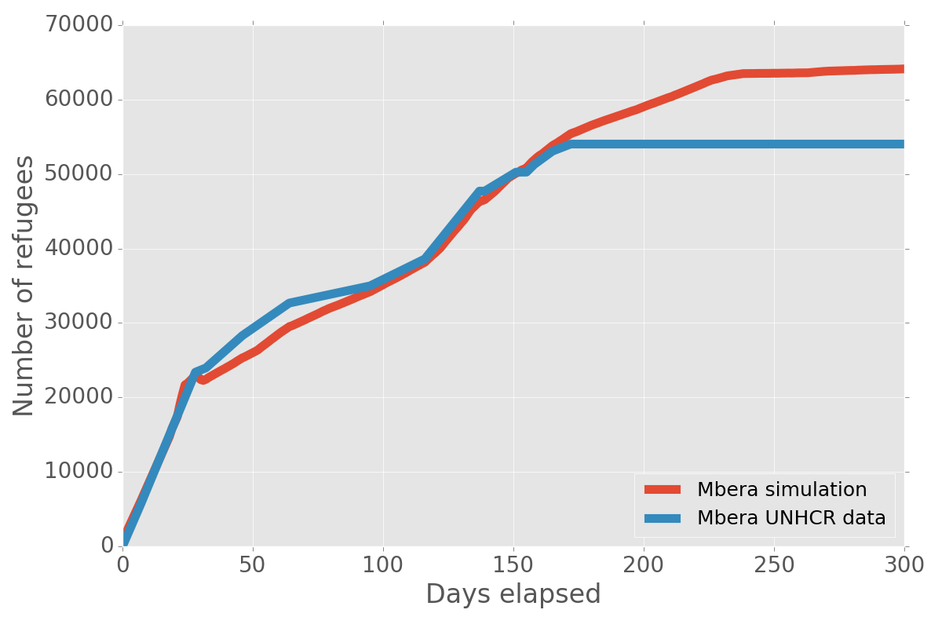
Effect of border closure
BF border open after 1 month (real).
BF border closed.

Slide 49
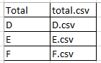
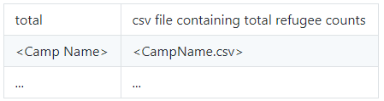
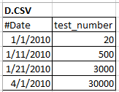
Structure of data sources for simulation
Validation data directory
Create data_layout.csv file names for each camp/destination locations

Slide 50
Summary of data structures
Three input CSV files:
<your_csv_input_directory>/locations.csv
<your_csv_input_directory>/routes.csv
<your_csv_input_directory>/closures.csv
Refugee data to validate against:
<your_validation_data_directory>/data_layout.csv
<your_validation_data_directory>/<name_of_camp_csv_file>
Run simulation using the CSV files:
mkdir -p <output_directory>
python3 run_csv_vanilla.py <your_csv_input_directory> <your_validation_data_directory> <duration in days> > <output_directory>/<output_csv_file>
python3 plot-flee-output.py <output_directory>

Slide 51
Simulations performed using Flee
Active simulations:
Script name | What it does
maliv2.py | Mali simulation
burundi.py | Burundi simulation
car.py | CAR simulation
ssudan-csv.py | South Sudan simulation
iraq-idp.py | Iraq simulation (IDPs only)

Slide 52
Simplified simulation of CAR situation
1. To run the (simplified) CAR simulation using CSV-based kernel:
$ mkdir outcar
$ python3 run_csv_vanilla.py examples/car_input_csv source_data/car2014 820 2010-01-01 > outcar/out.csv
* The output will be written to outcar/out.csv.
2. To visualize the output data:
$ python3 plot-flee-output.py outcar
* The output .png files will then appear in the outcar directory.
Run on Anaconda
runfile('run_csv_vanilla.py', args='test_data/test_input_csv test_data/test_input_csv/refugee_data 5 2010-01-01', wdir='D:/Codes/flee/flee-release')

Slide 53
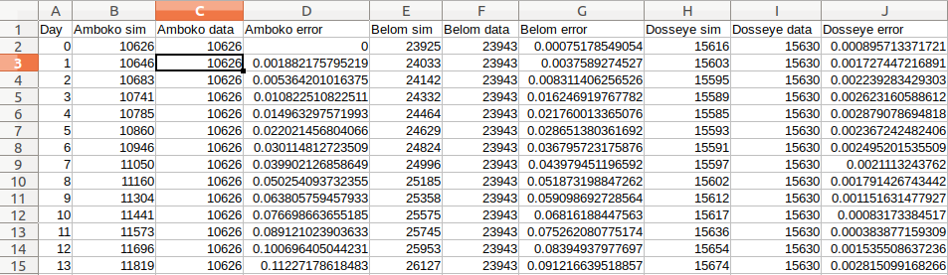
Using Flee for specific situations
Output #1 – all locations(camps)? for 820 days

Slide 54
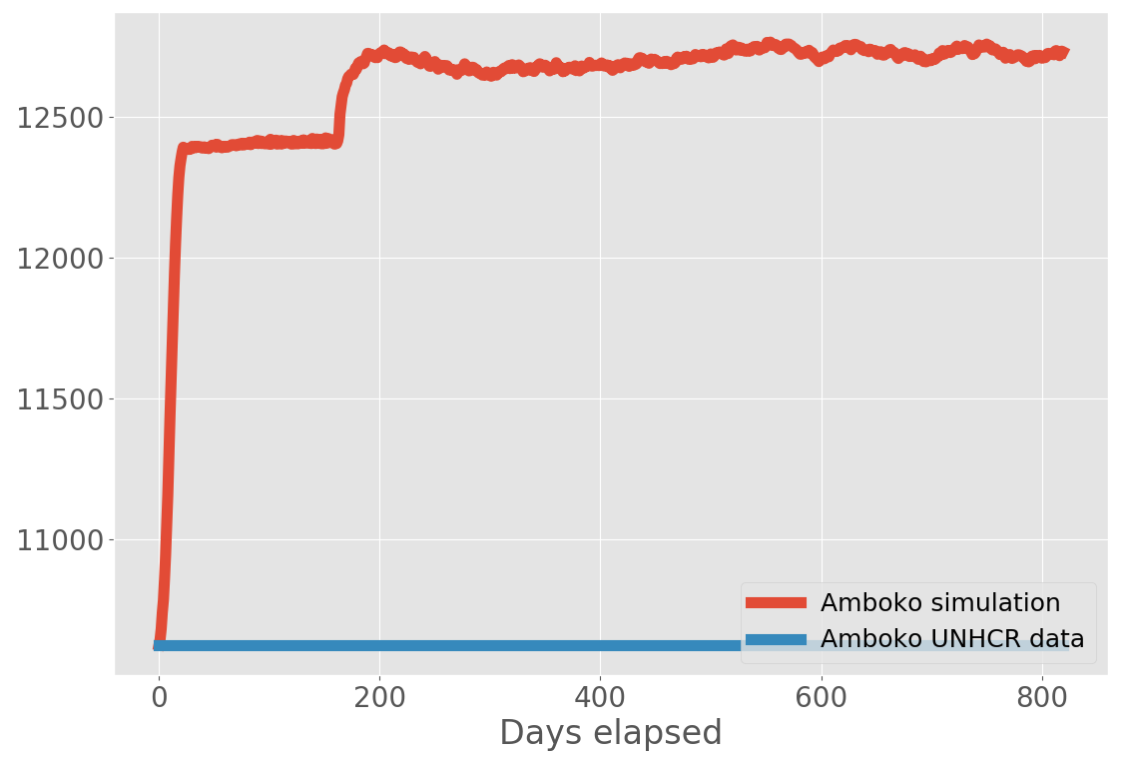
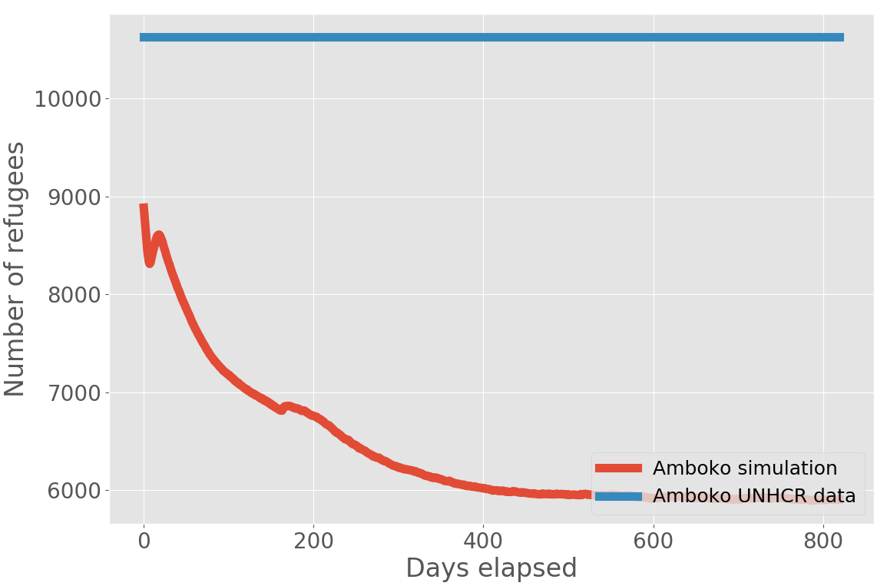
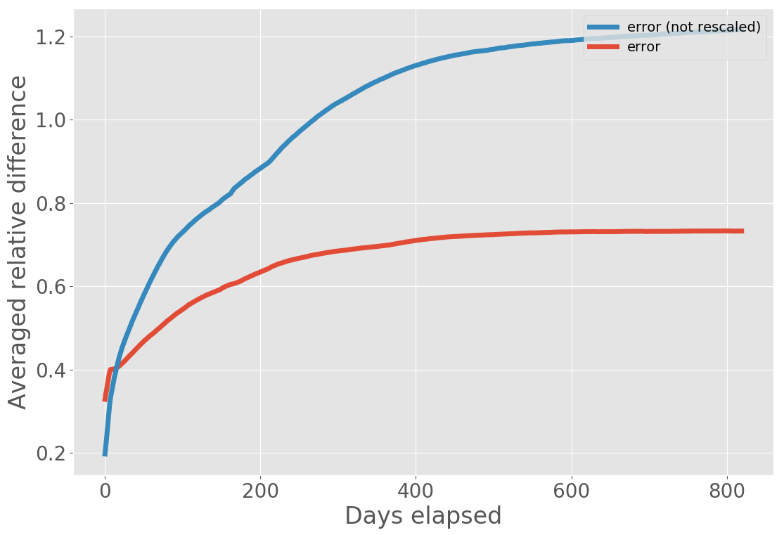
Using Flee for specific situations
Output #2 – visualization for Amboko, rescaled & error comparison

Slide 55
Simulating
forced migration
in
South Sudan

Slide 56
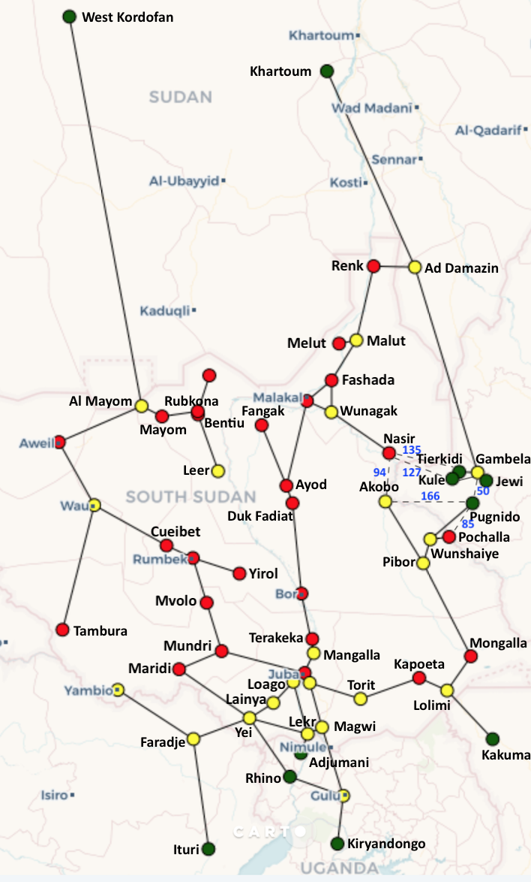
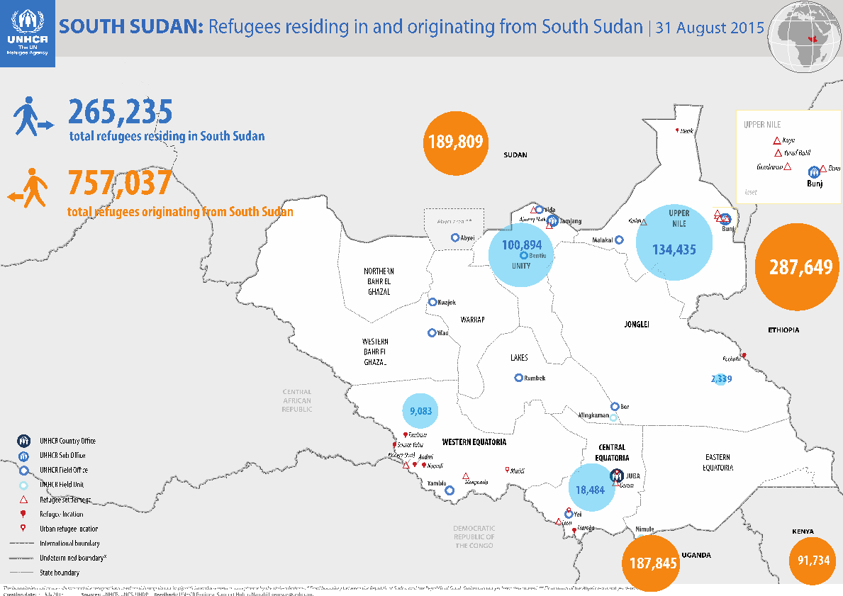
South Sudan Model
Simulation period 15 Dec 2013 – 10 Aug 2015
26 conflict zones
10 camps in neighbouring countries
Ethiopia, Kenya, Sudan, Uganda
Over 800 000 refugees by August 2015

Slide 57
Automation of refugee modelling
Problem selection
Data source selection
[manual]
Model construction
Model refinement
Simulation execution
Analysis
Construct single model
[FLEE CSV]
Generate models over parameter or policy range
[FabFLEE]
Ensemble execution
[FabSim + FLEE]
Validation
and
visualisation
FabSim + Flee = FabFlee

Slide 58
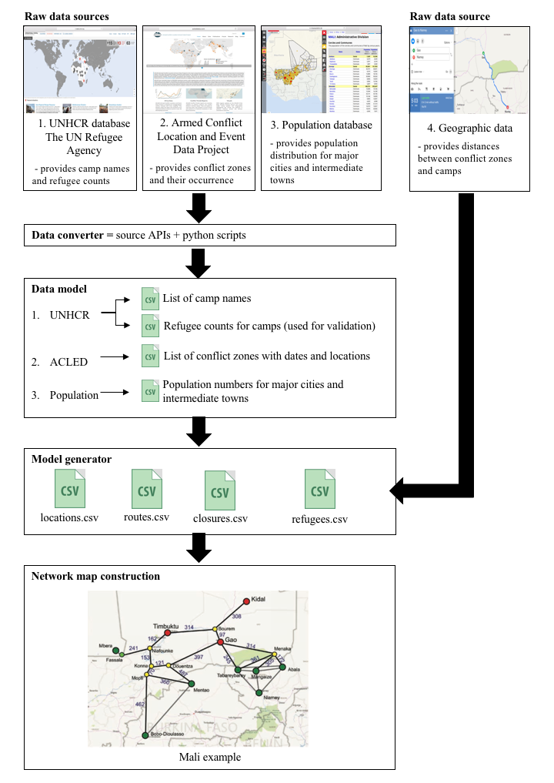

Data extraction
The model building approach for
refugee, conflict, population &
geographic data
Raw data sources
create unified input data
extract data to instantiate models
Suleimenova et al. (2017) “Towards an automated framework for agent-based simulation of refugee movements”. In W. K. V. Chan, A. D’Ambrogio, G. Zacharewicz, N. Mustafee, G. Wainer & E. Page (eds.), Proceedings of the 2017 Winter Simulation Conference, (pp. 1240–1251). Las Vegas, Nevada: IEEE

Slide 59
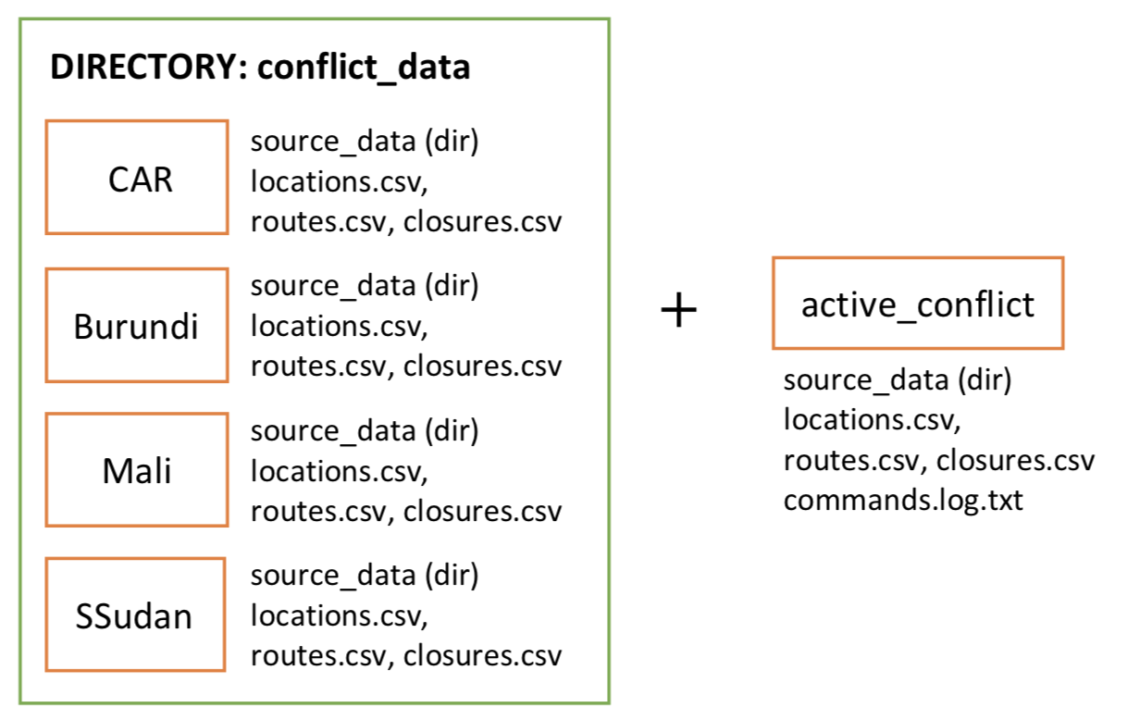
Initial model construction
To load initial model:
fab localhost load_conflict:conflict_name
e.g. fab localhost load_conflict:Mali
To clear active_conflict directory:
fab localhost clear_active_conflict
run.py

Slide 60
Model refinement
an exploration of parameters for policy decisions
Purpose:
to examine policy implications that can vary across conflicts
Parameters | Commands
Change camp capacity | fab localhost change_capacities:camp_name=capacity (,came_name2=capacity2)
Add new camp | fab localhost add_camp:camp_name,region,country(,lat,lon)
Delete location | fab localhost delete_location:location_name
Camp closure | fab localhost close_camp:camp_name,country,closure_start,closure_end
Border closure | fab localhost close_border:country1,country2,closure_start,closure_end
Forced redirection | fab localhost redirect:source,destination,redirect_start,redirect_end

Slide 61
Simulation execution
Instantiate simulation with changed parameters of conflict scenario:
fab localhost instantiate:conflict_name
e.g. fab localhost instantiate:mali
Execution of simulation run:
fab localhost flee:flee_conflict_name
e.g. fab localhost flee:flee_mali

Slide 62
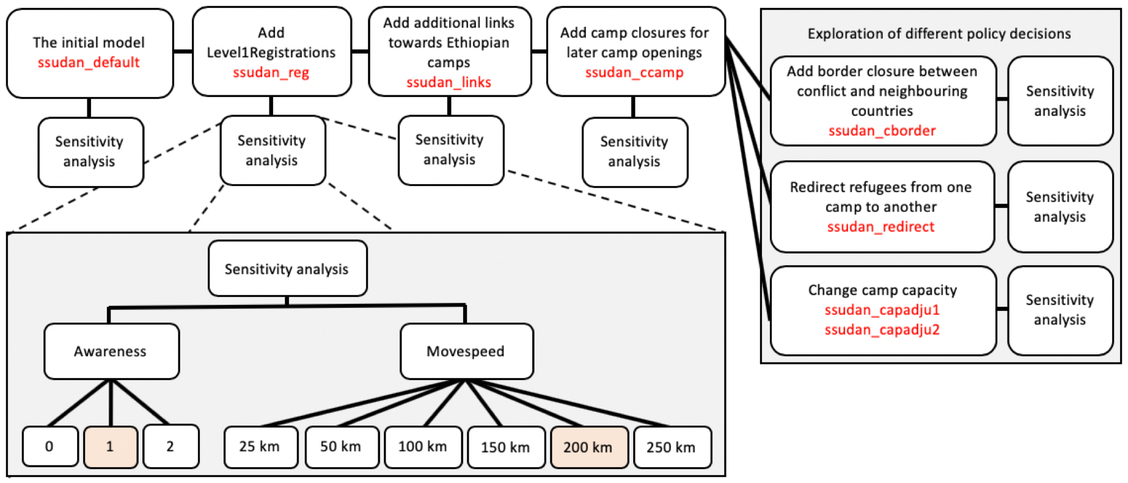
Setup of simulation execution

Slide 63
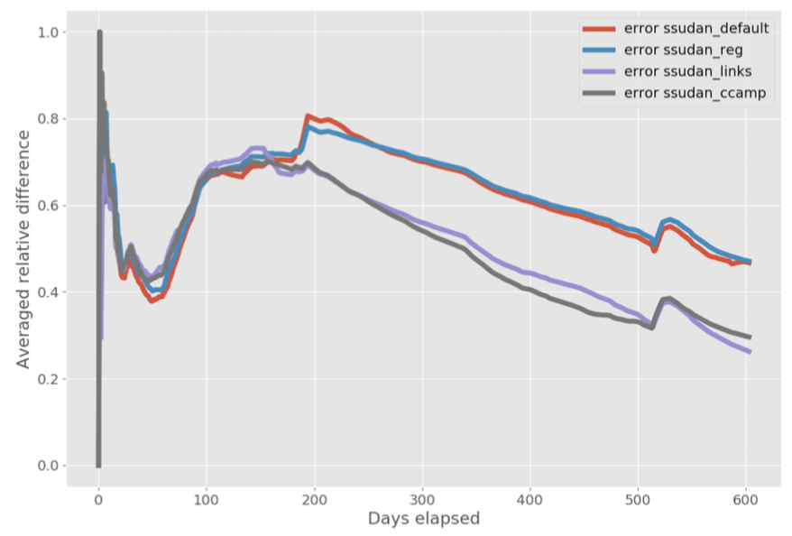
Simulation results
Simulation runs persistently lessens respectively from 0.615 to 0.499 over the simulation period
Overview of the averaged relative differences

Slide 64
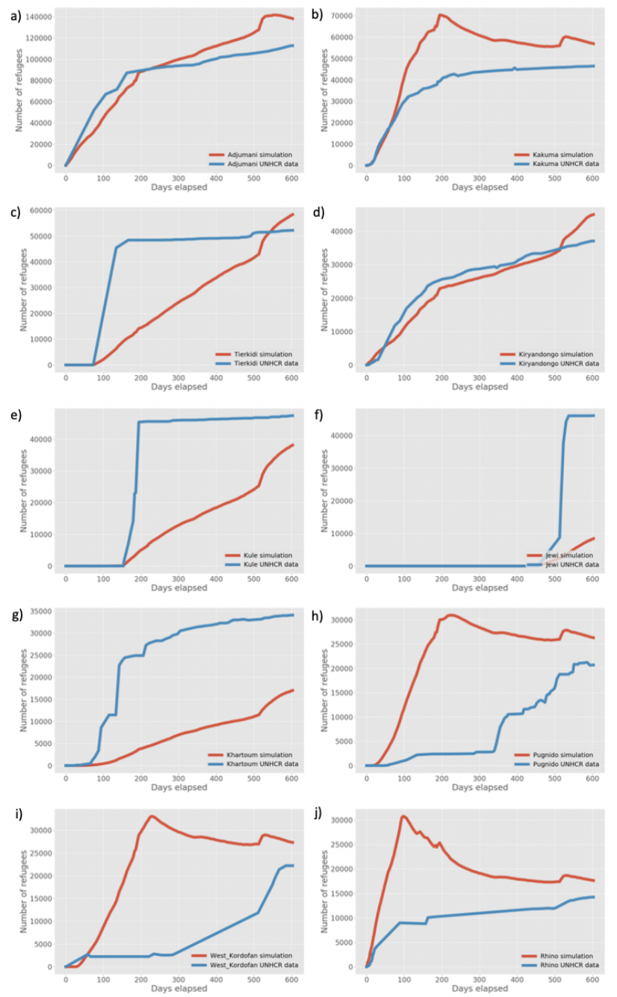
Simulation results
The most populous camp (Adjumani) with more than 140,000 refugees over the simulation period
Refugee counts in Kiryandongo and Kakuma are in close agreement with the UNHCR data
Simulations underpredict for Kule, Jewi and Khartoum camps
Kakuma (45239), Pugnido (42044), Rhino (5313) and Kiryanongo (15) camps had registered number of refugees fled prior to the simulation start
Notes:
The most populous camp in our simulation is Adjumani with more than 140,000 refugees over the simulation period and slightly overpredicted after 200 days into simulation compare to the data. The reason being that it is the closest camp for refugees fleeing from the South Sudan conflict. The forecast refugee counts in Kiryandongo and Kakume (at the start prior to 100 days) are in close agreement with the UNHCR data, while our simulations underpredict for Kule, Jewi and Khartoum camps. South Sudan has a record of being in conflict prior to our simulation start date. Kakuma (45239), Pugnido (42044), Rhino (5313) and Kiryanongo (15) camps had registered number of refugees fled prior to the simulation start; these, therefore, do not count towards the refugee arrival numbers.

Slide 65
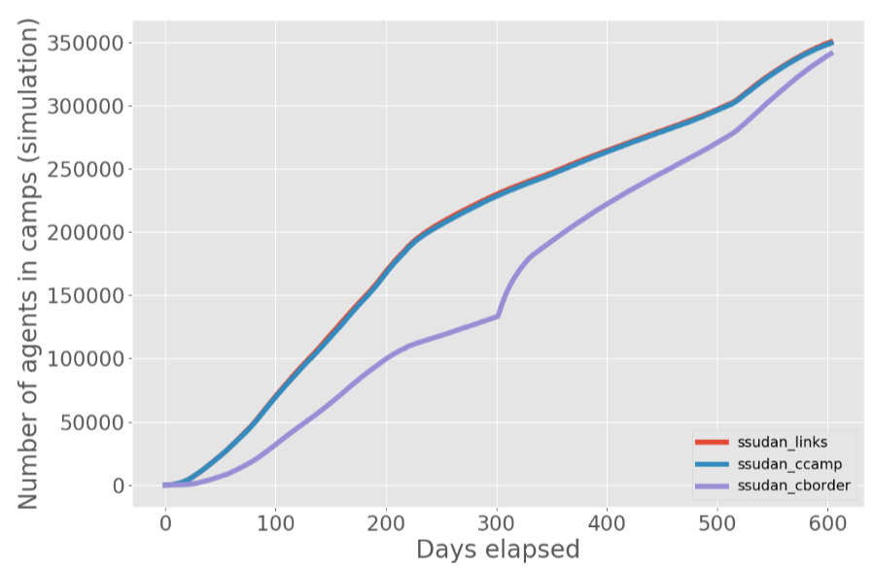
Camp and border closures
Comparison of number of refugees in camps between no closure, camp closure and border closure

Slide 66
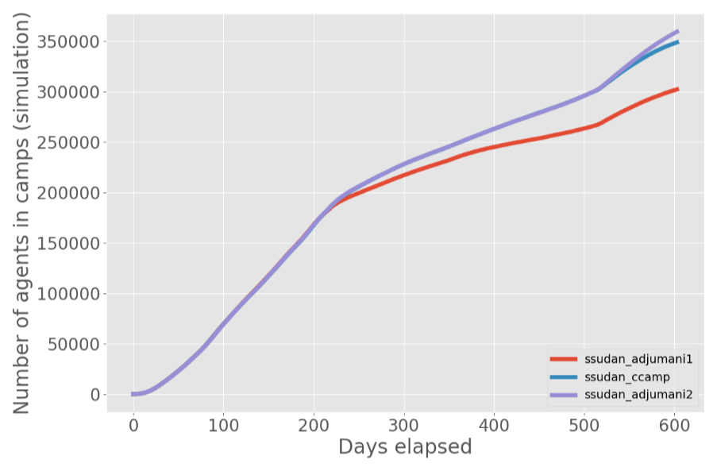
Camp capacity changes
Comparison of number of refugees in camps between three simulations with capacity change for Adjumani camp in comparison to the base model of ssudan_ccamp.

Slide 67
Hands-on:
Using Flee for specific situations

Slide 68
Run simulation instance
Try #1 – for forced migration model for South Sudan
Try #2 visualize
Discuss results

Slide 69
Discuss in groups
(with note taking):
How we can make these simulations more realistic and accurate, or answer more relevant questions

Slide 70
Making simulations more realistic
Make group of 5 members.
Nominate group rapporter.
Use the following starting points.
Carry-on discussion for 15 minutes.
Write down the agreed upon points on sticky notes.

Slide 71
Customizing Flee for own needs
To what extent can the Flee simulation code fit into the Ethiopian context?
What features should be modified or added into the Flee?
Discuss on the performance of Flee simulation code.
What features should be modified or added into the Flee to enhance its accuracy?

Slide 72
Summary
Flee migration model basics: Agent-based modelling and the Flee code.
Basic Flee simulations: hands-on Flee, migration simulation scenarios, and discussion on customizing Flee for the Ethiopian context.
Using Flee for specific situations: Hands-on using Flee for specific situations.
Lecture on simulating forced migration in South Sudan.
Discussion on how to make simulations more realistic and accurate.
Notes:
Lecture 50 minutes:, discussion: 40 minutes, hands-on: 75 minutes, break: 15 minutes.

Slide 73
References
Suleimenova, D., Bell, D., & Groen, D. (2017). A generalized simulation development approach for predicting refugee destinations. Scientific reports, 7(1), 13377.
Groen, D. (2016). Simulating refugee movements: Where would you go?. Procedia Computer Science, 80, 2251-2255.
Suleimenova, D., Bell, D., & Groen, D. (2017, December). Towards an automated framework for agent-based simulation of refugee movements. In 2017 Winter Simulation Conference (WSC) (pp. 1240-1251). IEEE.
Kniveton, D. R., Smith, C. D., & Black, R. (2012). Emerging migration flows in a changing climate in dryland Africa. Nature Climate Change, 2(6), 444.
Campos, C. V., Suleimenova, D., & Groen, D. (2019, June). A Coupled Food Security and Refugee Movement Model for the South Sudan Conflict. In International Conference on Computational Science (pp. 725-732). Springer, Cham.

Slide 74
Q & A

